Slide 1
Geography
Topic :climate
Sub topic : climatic zones

Slide 2
Lesson objectives
Identify deferent climatic regions.
Differentiate between weather and climate
Explain Why we have different climatic conditions in different zones of the world
Prepare an infographic on climatic zones of the world.

Slide 3
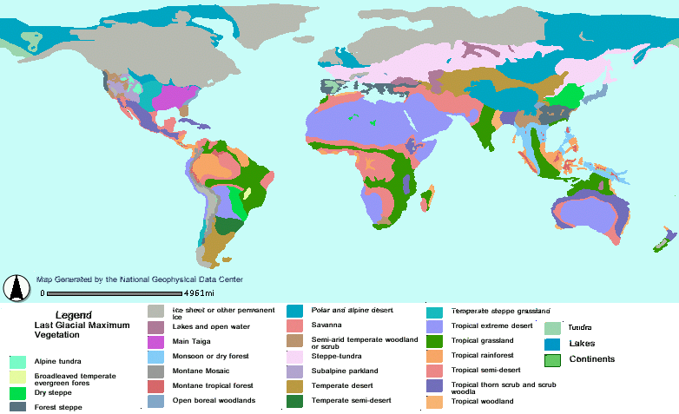
Different climatic zones of the world

Slide 4
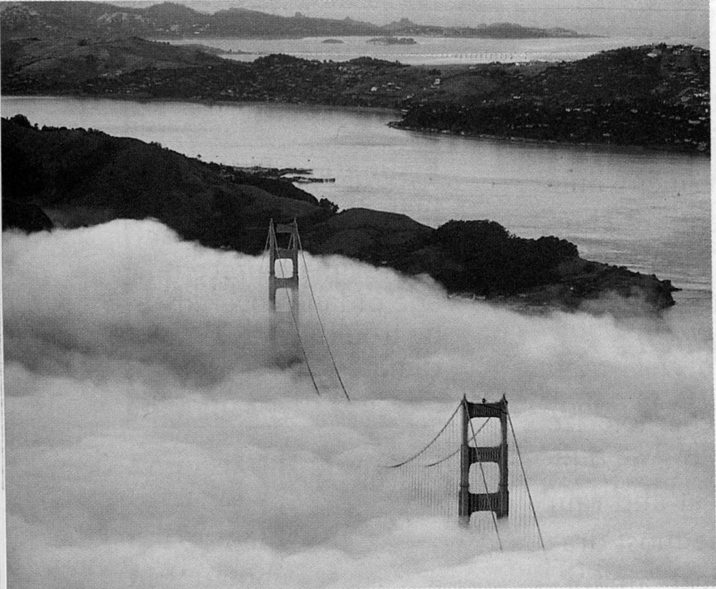

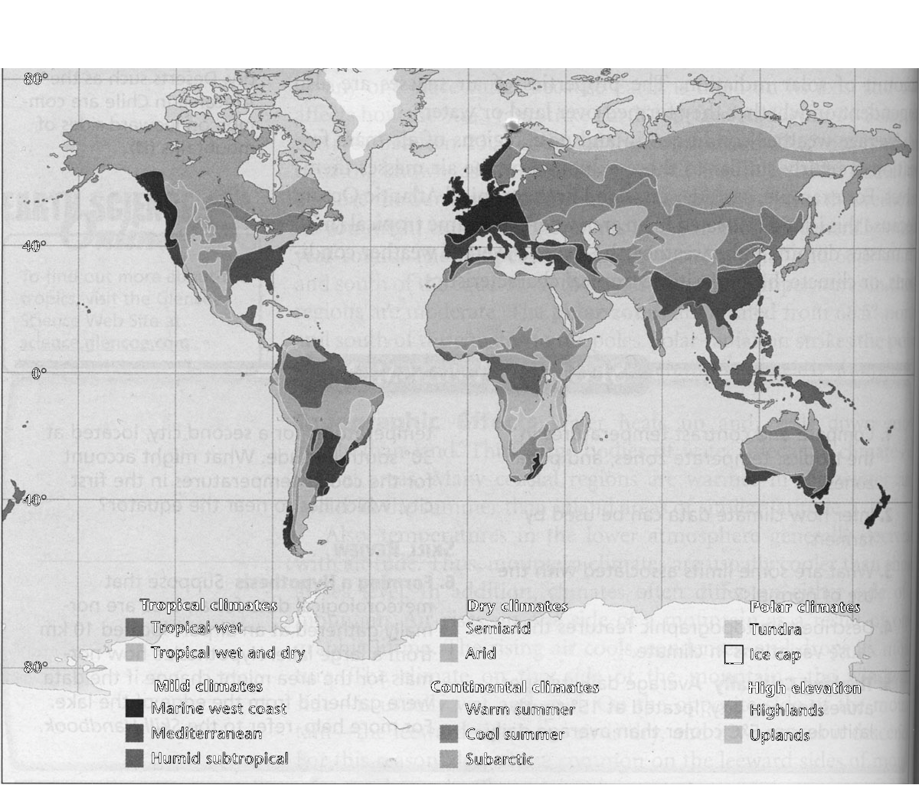
What Causes Different Climates?
Map of World Climates
1

Slide 5
I. The Significance of Climate
A. What is the difference between
Climate and Weather?
1. Climate: the average, long-term pattern of weather in a region
2. Weather: the state of the atmosphere at a certain time and place
Both climate and weather are measured in terms of temperature, wind speed, humidity, cloudiness, precipitation and other variables.
II. Global Climate Controls
Latitude
Altitude
Proximity to H₂O
Topography
Ocean Currents
Prevailing winds
2

Slide 6
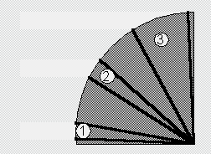
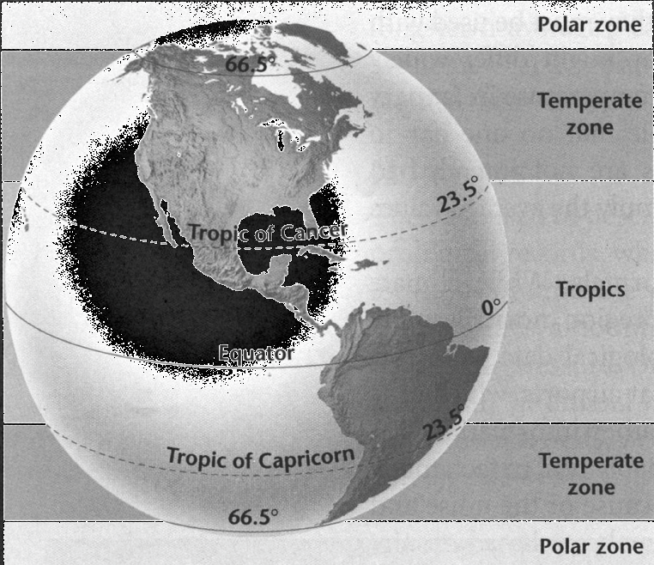
A. Latitude
1. Because the Earth tilts on its axis, and because the earth is spherical the Sun’s rays strike the Earth at different angles.
a. as a result, different parts of Earth receive different amounts of solar radiation.
Compare area #1 to area #3. Notice in area #3 the given amount of light (and heat) is spread over a larger area, so the energy is less concentrated.
3. The tropics receive the most solar radiation
because the sun’s rays
strike almost directly. Temperatures in the tropics are warm year- round.
4. The temperate zones have moderate conditions.
5. The polar zones receive the least radiation because the sun’s rays strike at a very
low angle. Temperatures in polar regions are usually cold.
3

Slide 7
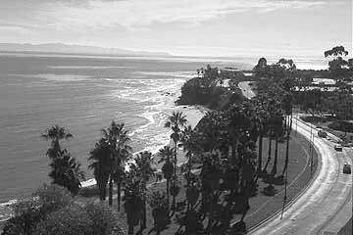
B. Altitude
1. Altitude is the height above sea level.
2. On average, temperatures drop about
1ºC for every 160 m of altitude.
3. The higher the altitude, the lower the average yearly temperature.
C. Proximity to H₂O
1. Land gains and loses heat much faster than water.
2. Based on other factors certain areas closer to large
temperature range.
seaboard of the U.S.A.
3. Continental interiors have large yearly temperature
bodies of water may have a relatively small yearly
a. example: the California coast vs. the north-eastern
ranges.
4

Slide 8
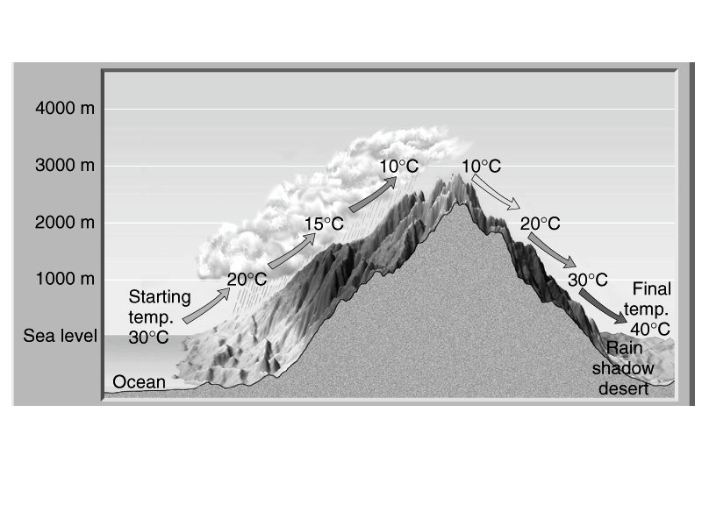
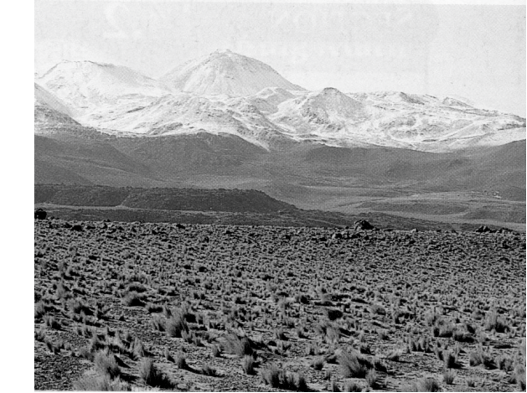
D. Topography
1. Climates often differ on either side of a mountain.
2. As air rises over a mountain, it cools. As it cools, it condenses, and releases moisture (rain). This is called the windward side.
3. As the dry air flows over the mountain, it descends and warms, usually producing deserts.
This is called the leeward side.
Deserts such as the Atacama in Chile are common on leeward sides of mountains.
5

Slide 9
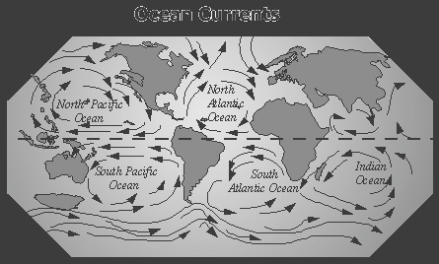
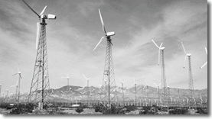
E. Ocean Currents
1. Ocean currents can warm or cool the air above.
2. Ocean currents may be considerably warmer or colder than the normal air temperature for that
latitude.
F. Prevailing Winds
1. There are three basic wind systems in each hemisphere: Polar Easterlies, Northeast or Southeast Tradewinds and Prevailing Westerlies.
2. These winds blow air masses with distinct regions of origin (ie. formed over land or water, formed at certain latitudes).
3. The interaction and movement of air masses affect climate.
6

Slide 10
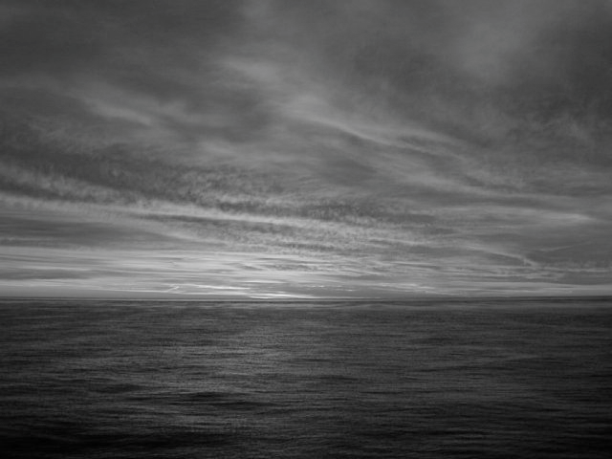
7

